Slide 1
DBMS Serializability/Serializable Schedule

Slide 2
The serializability of schedules is used to find non-serial schedules that allow the transaction to execute concurrently without interfering with one another.
It identifies which schedules are correct when executions of the transaction have interleaving of their operations.
A non-serial schedule will be serializable if its result is equal to the result of its transactions executed serially.

Slide 3
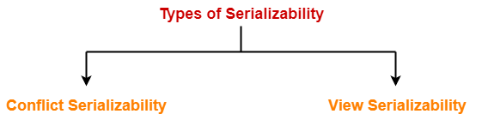

Slide 4
Conflict Serializability
The database system must control concurrent execution of transaction which ensure that the database state remains in consistent state.

Slide 5
conflict
A pair of consecutive database actions read and write is in conflict if changing their order would change the result of at least one of the transactions.
 | READ(D) | WRITE(D)
READ(D) | NO CONFLICT | CONFLICT
WRITE(D) | CONFLICT | CONFLICT

Slide 6
Consider schedule S has two consecutive instaructions Ii and Ij from transaction Ti and Tj .
If Ii and Ij access two different data items then they will not conflict and can be swapped without any problem.
If Ii and Ij access same data items then consider following things:

Slide 7
Ii = READ(D) and Ij=READ(D) then no conflict.
This operation is called non conflicting swap.
Ii = READ(D) and Ij=WRITE(D) they conflict and can not be swapped.
Ii = WRITE(D) and Ij=READ(D) they conflict and can not be swapped.
Ii = WRITE(D) and Ij=WRITE(D) they conflict and can not be swapped.

Slide 8
Ii =READ/ WRITE(D) and Ij=WRITE(P)/READ(P) then no conflict.

Slide 9
Following sets of operations are conflicting
T1:R(X), T2:W(X) , T3:W(X)
While following are not:
T1:R(X), T2:R(X) , T3:R(X)
T1:R(X), T2:W(Y) , T3:R(X)

Slide 10
T1 | T2
READ(P)
WRITE(P)
 | READ(P)
READ(Q)
 | WRITE(P)
WRITE(Q)
 | READ(Q)
 | WRITE(Q)

Slide 11
T1 | T2
READ(P)
WRITE(P)
 | READ(P)
READ(Q)
 | WRITE(P)
WRITE(Q)
 | READ(Q)
 | WRITE(Q)

Slide 12
T1 | T2
READ(P)
WRITE(P)
 | READ(P)
READ(Q)
 | WRITE(P)
WRITE(Q)
 | READ(Q)
 | WRITE(Q)

Slide 13
T1 | T2
READ(P)
WRITE(P)
READ(Q)
 | READ(P)
 | WRITE(P)
WRITE(Q)
 | READ(Q)
 | WRITE(Q)

Slide 14
T1 | T2
READ(P)
WRITE(P)
READ(Q)
 | READ(P)
 | WRITE(P)
WRITE(Q)
 | READ(Q)
 | WRITE(Q)

Slide 15
T1 | T2
READ(P)
WRITE(P)
READ(Q)
 | READ(P)
WRITE(Q)
 | WRITE(P)
 | READ(Q)
 | WRITE(Q)

Slide 16
T1 | T2
READ(P)
WRITE(P)
READ(Q)
 | READ(P)
WRITE(Q)
 | WRITE(P)
 | READ(Q)
 | WRITE(Q)

Slide 17
T1 | T2
READ(P)
WRITE(P)
READ(Q)
WRITE(Q)
 | READ(P)
 | WRITE(P)
 | READ(Q)
 | WRITE(Q)

Slide 18
THE ABOVE SCHEDULE IS SAME AS SERIAL SCHEDULE

Slide 19
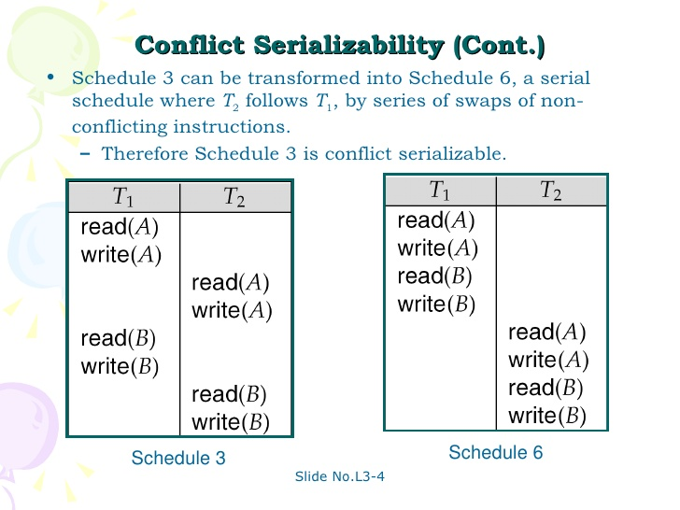

Slide 20
View Serilaizability
View equivalence is less strict than conflict equivalence.
A Schedule is called view serializable if it is view equal to a serial schedule (no overlapping transactions).

Slide 21
Conditions for view equivalence
Let, D= Data item
S1,S2= Transaction schedules
Ti,Tj= database transaction
Schedule s1 and s2 are view equivalent if they satisfy following conditions for each data item D.

Slide 22
Rule 1
S1 and s2 must have same transactions included and also they are performing same operations on same data. If Ti reads initial value of D in s1 then Ti also reads initial value of D in S2.

Slide 23
Rule 2
If Ti reads value of D written by Tj in S1 then Ti also reads value of D written by Tj in S2

Slide 24
Rule 3
If Ti writes final value of D in S1 then Ti also writes final value of D in S2.

Slide 25
Initial Read
If a transaction T1 reading data item A from initial database in S1 then in S2 also T1 should read A from initial database.
T1 T2 T3
-------------------
R(A)
W(A)
R(A)
R(B)
Transaction T2 is reading A from initial database.

Slide 26
Updated Read
If Ti is reading A which is updated by Tj in S1 then in S2 also Ti should read A which is updated by Tj.
T1 T2 T3 T1 T2 T3
------------------- ----------------
W(A) W(A)
W(A) R(A)
R(A) W(A)

Slide 27
Above two schedule are not view equal as in S1 :T3 is reading A updated by T2, in S2 T3 is reading A updated by T1.

Slide 28
Final Write operation
If a transaction T1 updated A at last in S1, then in S2 also T1 should perform final write operations.
T1 T2 T1 T2
------------ ---------------
R(A) R(A)
W(A) W(A)
W(A) W(A)

Slide 29
Above two schedule are not view as Final write operation in S1 is done by T1 while in S2 done by T2.

Slide 30
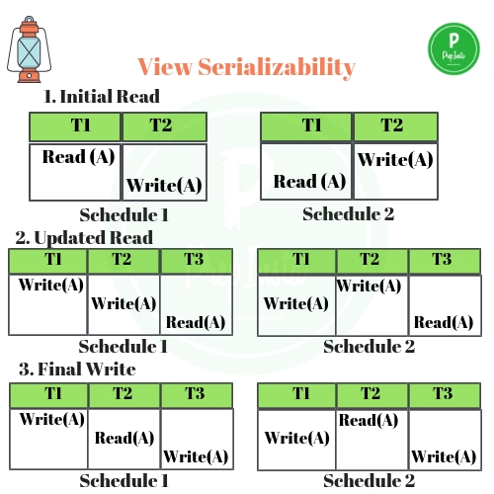

Slide 31
Thank you !

